Slide 1



Slide 2

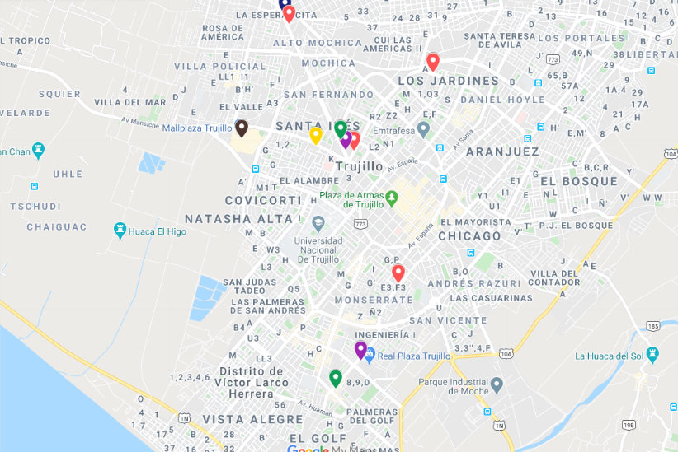
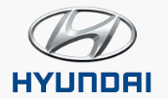




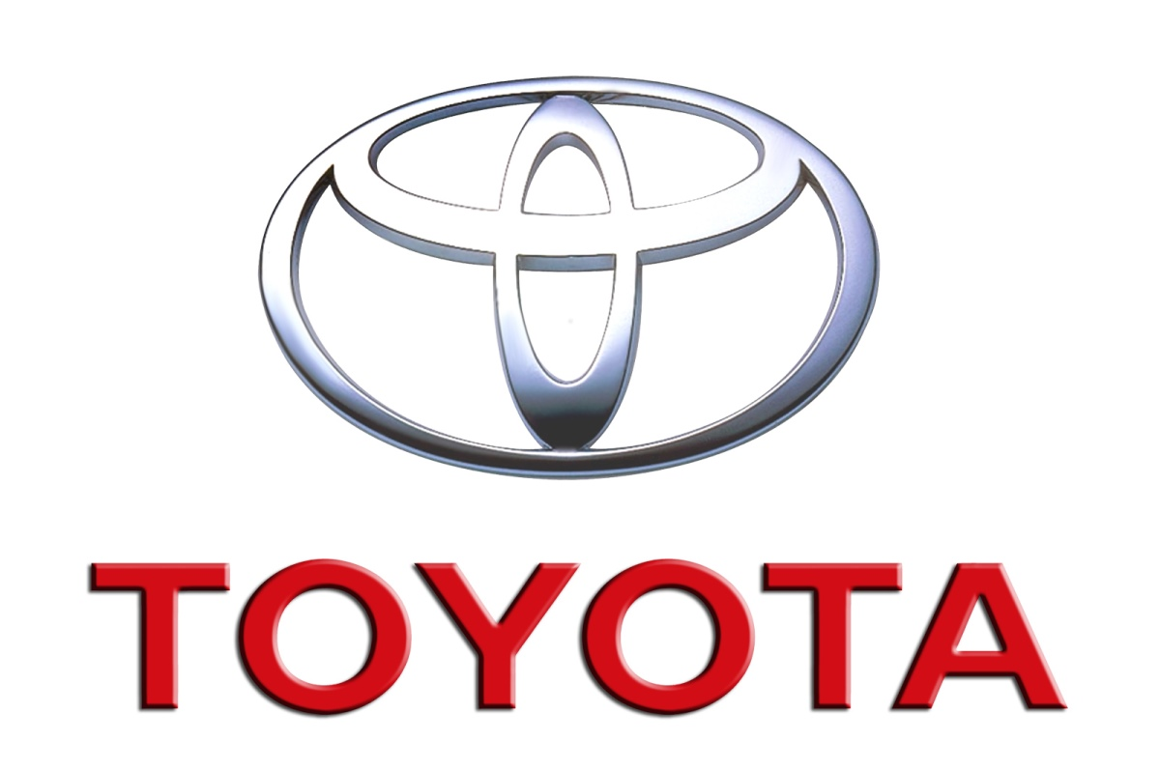
La Libertad – 8% del volume total
Market Share
Por grupo:
1. Toyota – 25.2%
2. Derco - 24.3%
3. Gildemeister – 19.0%
4. SKB – 12.8%
5. GM – 5-2%
Por Marca:
1. Toyota – 25.2%
2. Hyundai – 15.4%
3. Kia - 7.1%
4. Great wall – 6.4%
5. Chevrolet – 5.2%
6. JAC – 4.7%
7. Suzuki – 3.6%
8. Renault – 3.5%
9. Changan - 3.5%
11. Nissan – 2.8%
16. Mazda – 1.6%
13. Haval – 0.8%

Slide 3
Amazonas – del volume total
Market Share
Por grupo:
1. Toyota – 65.0%
2. Derco - 35.0%
Por Marca:
1. Toyota – 65.0%
2. Suzuki – 25.0%
3. Changan – 5.0%
4. Renault – 5.0%

Slide 4
Ancash – del volume total
Market Share
Por grupo:
1. Toyota – 40.0%
2. Gildemeister – 25.2%
3. SKB – 15.8%
4.Nissan - 7.4%
5. Derco – 5-9%
Por Marca:
1. Toyota – 40.0%
2. Hyundai – 23.0%
3. Kia - 10.0%
4. Nissan – 7.4%
5. Ford – 3.5%
6. Chery – 3.1%
7. Mitsubishi – 2.7%
8. JAC – 2.3%
9. Volskwagen – 1.4%
10. Changan – 1.2%
11. Geely – 1.2%
12. Great Wall – 0.6%
13. Renault - 0.6%
14. Haval – 0.6%

Slide 5
Arequipa – del volume total
Market Share
Por grupo:
1. Toyota – 19.0%
2. Derco – 19.0%
3. Gildemeister – 18.4%
4.SKB - 13.7%
5. GM – 8.3%
Por Marca:
1. Toyota – 19.0%
2. Hyundai – 16.5%
3. Kia - 10.1%
4. Chevrolet – 8.3%
5. Changan – 7.8%
6. Renault – 4.9%
7. Volkswaguen – 4.4%
8. Nissan – 3.8%
9. Mitsubishi – 2.9%
10. Ford – 2.5%
11. JAC – 1.8%
12. Mazda – 1.7%
13. Suzuki – 1.2%
14. Subaru – 1.1%

Slide 6
Cajamarca – del volume total
Market Share
Por grupo:
1. Toyota – 38.6%
2. Derco – 23.4%
3. Gildemeister – 14.6%
4.SKB - 6.7%
5. Euromotors– 4.9%
Por Marca:
1. Toyota – 38.6%
2. Changan – 12.7%
3. Hyundai - 11.4%
4. Volkswaguen – 4.7%
5. Chevrolet – 4.5%
6. Ford – 4.1%
7. Kia – 3.4%
8. Mitsubishi – 3.0%
9. Suzuki – 2.8%
10. JAC – 2.8%
11. Renault – 1.9%
12. DFSk – 1.3%
13. Geely – 1.3%
14. Great Wall – 1.3%

Slide 7
Cusco – del volume total
Market Share
Por grupo:
1. Toyota – 27.5%
2. Derco – 22.8%
3. Gildemeister – 20.4%
4.SKB - 17.2%
5. GM– 3.9%
Por Marca:
1. Toyota – 27.5%
2. Hyndai – 18.7%
3. Suzuki - 13.9%
4. Kia – 13.4%
5. Chevrolet – 3.9%
6. Changan – 3.6%
7. Mitsubishi – 2.9%
8. Volkswaguen – 2.3%
9. JAC – 1.8%
10. Renault – 1.7%
11. Ford – 1.7%
12. Nissan – 1.2%
13. Jinbei – 0.9%
14. Great Wall – 0.8%

Slide 8
Huánuco – del volume total
Market Share
Por grupo:
1. Toyota – 70.7%
2. Derco – 13.5%
3. Gildemeister – 4.3%
4.SKB - 4.3%
5. Nissan – 2.9%
Por Marca:
1. Toyota – 70.7%
2. Changan – 4.3%
3. Hyundai - 4.3%
4. JAC – 3.4%
5. Nissan – 2.9%
6. Mitsubishi – 2.4%
7. Renault – 1.9%
8. Great Wall – 1.9%
9. Ford – 1.4%
10. Kia – 1.4%
11. Suzuki – 1.0%
12. Haval – 1.0%

Slide 9
Ica – del volume total
Market Share
Por grupo:
1. Derco – 67.1%
2. Nissan – 24.9%
3. Gildemeister – 4.6%
4.Toyota - 2.9%
Por Marca:
1. Nissan – 24.9%
2. Changan – 17.9%
3. JAC - 14.5%
4. Renault – 12.1%
5. Suzuki – 11.6%
6. Great Wall– 7.5%
7. Hyndai – 4.6%
8. Toyota – 2.9%
9. Haval – 2.3%
10. Mazda – 1.2%
11. Foton– 0.6%

Slide 10
Huánuco – del volume total
Market Share
Por grupo:
1. Toyota – 70.7%
2. Derco – 13.5%
3. Gildemeister – 4.3%
4.SKB - 4.3%
5. Nissan – 2.9%
Por Marca:
1. Toyota – 70.7%
2. Changan – 4.3%
3. Hyundai - 4.3%
4. JAC – 3.4%
5. Nissan – 2.9%
6. Mitsubishi – 2.4%
7. Renault – 1.9%
8. Great Wall – 1.9%
9. Ford – 1.4%
10. Kia – 1.4%
11. Suzuki – 1.0%
12. Haval – 1.0%

Slide 11
Junín – del volume total
Market Share
Por grupo:
1. Derco – 37.6%
2. Toyota – 33.3%
3. SKB – 6.4%
4. Nissan – 3.6%
5. Euromotors – 3.4%
Por Marca:
1. Toyota – 33.3%
2. JAC – 9.1%
3. Changan - 8.1%
4. Great Wall – 8.1%
5. Suzuki – 6.4%
6. Kia – 5.0%
7. Nissan – 3.6%
8. Renault – 3.4%
9. Volkswaguen – 3.4%
10. Ford – 3.3%
11. Chevrolet – 2.5%
12. Foton– 2.3%
13. DFSK – 2.2%
14. Mazda – 1.3%

Slide 12
Lambayeque – del volume total
Market Share
Por grupo:
1. Derco – 22.4%
2. SKB– 21.9%
3. Gildemeister – 21.9%
4. Toyota– 18.2%
5. Nissan – 8.1%
Por Marca:
1. Hyndai – 19.2%
2. Toyota – 18.2%
3. Kia - 8.4%
4. Nissan – 8.1%
5. Changan – 6.7%
6. Chery – 6.3%
7. Mitsubishi – 5.4%
8. Renault – 4.9%
9. Suzuki – 3.6%
10. Volkswaguen – 3.1%
11. Mazda – 2.2%
12. Great Wall– 1.8%
13. JAC – 1.6%
14. Chevrolet – 1.5%

Slide 13
Lima – del volume total
Market Share
Por grupo:
1. Derco – 19.2%
2. Toyota – 14.9%
3. SKB – 14.1%
4. Gildemeister – 12.9%
5. Inchcape/Indumotora – 8.9%
Por Marca:
1. Toyota – 14.7%
2. Hyndai – 10.4%
3. Kia - 8.1%
4. Chevrolet – 7.4%
5. Nissan – 5.6%
6. DFSK – 4.8%
7. Volkswaguen – 4.4%
8. Suzuki – 4.3%
9. Mazda – 3.5%
10. Changan – 3.1%
11. Renault – 3.0%
12. Ford– 2.9%
13. Mitsubishi – 2.7%
14. Subaru – 2.3%
15. JAC – 2.2%
16. Great Wall – 1.9%

Slide 14
Piura – del volume total
Market Share
Por grupo:
1. SKB – 19.2%
2. Toyota – 14.9%
3. Gildemeister – 14.1%
4. Nissan – 12.9%
5. Eurmotors – 8.9%
6. Derco – 3.3%
Por Marca:
1. Toyota – 22.8%
2. Kia – 15.3%
3. Hyndai - 13.5%
4. Chery – 10.5%
5. Chevrolet – 8.5%
6. Mitsubishi – 7.2%
7. Nissan – 5.9%
8. Volkwaguen – 4.6%
9. Jinbei – 1.7%
10. JMC – 1.6%
11. Honda – 1.2%
12. MG– 1.0%
13. Changan – 0.9%
14. JAC – 0.7%

Slide 15
Puno – del volume total
Market Share
Por grupo:
1. Derco – 29.7%
2. Toyota – 21.0%
3. Gildemeister – 16.4%
4. SKB – 13.0%
5. GM – 5.7%
Por Marca:
1. Toyota – 21.0%
2. Hyndai – 13.3%
3. Renault - 13.0%
4. Changan – 11.3%
5. Kia – 9.5%
6. Chevrolet – 5.7%
7. Fighter – 3.3%
8. Ford – 3.0%
9. Suzuki – 2.6%
10. Mitsubishi – 2.0%
11. JAC – 1.8%
12. Chery– 1.5%
13. Jinbei – 1.3%
14. Keyton – 1.3%

Slide 16
San Martín – del volume total
Market Share
Por grupo:
1. Derco – 46.3%
2. Toyota – 42.4%
3. SKB– 5.6%
4. Euromotors – 5.6%
Por Marca:
1. Toyota – 42.4%
2. Renault – 19.2%
3. Changan - 9.0%
4. Volkswaguen – 5.6%
5. JAC – 5.6%
6. Mitsubishi – 5.1%
7. Mazda – 5.1%
8. Suzuki – 4.0%
9. Great Wall – 2.3%
10. Haval – 0.6%
11. Citroen – 0.6%
12. Kia– 0.6%

Slide 17
Tacna – del volume total
Market Share
Por grupo:
1. Toyota – 32.0%
2. Gildemeister – 22.4%
3. Derco – 14.3%
4. SKB – 11.4%
5. GM – 6.1%
Por Marca:
1. Toyota – 32.0%
2. Hyndai – 18.6%
3. Kia - 10.4%
4. Chevrolet – 6.1%
5. JAC – 2.9%
6. Nissan – 2.7%
7. Mazda – 2.7%
8. Renault – 2.4%
9. Volkswaguen – 2.4%
10. Changan – 2.4%
11. Ford – 2.2%
12. Great Wall – 1.8%
13. Jinbei – 1.6%
14. Suzuki – 1.4%

Slide 18
Ucayali – del volume total
Market Share
Por grupo:
1. Toyota – 51.5%
2. Derco – 22.3%
3. Gildemeister – 17.7%
4. Nissan – 7.7%
Por Marca:
1. Toyota – 51.5%
2. Hyndai – 13.1%
3. Renault - 9.2%
4. Nissan – 7.7%
5. Suzuki – 3.8%
6. Great Wall – 3.1%
7. JAC – 3.1%
8. Jinbei – 1.5%
9. Geely – 1.5%
10. Changan – 1.5%
11. Baic – 1.5%
12. Citroen – 0.8%
13. Ford – 0.8%
14. Haval – 0.8%

